Slide 1
Overthewire – Natas 6-10
Write up by Chanan shenker

Slide 2
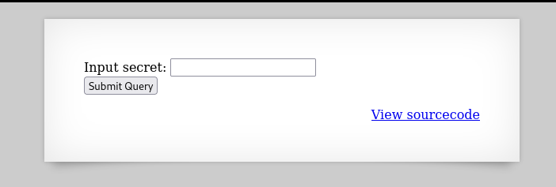
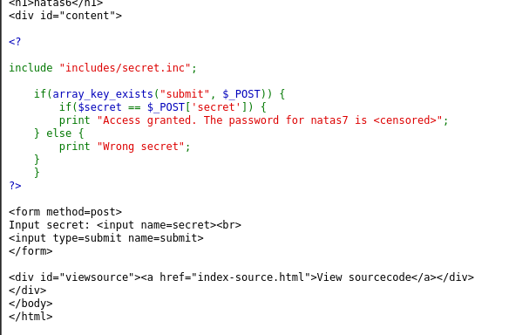
Last we left off we solved natas5 and got the password for natas6.
Natas6:
For this we get a query box (anywhere on a web page that you can submit info).
If we take a look at the source code we can see that if we submit the ‘secret’ well get granted access to natas7
so let look for the secret.

Slide 3
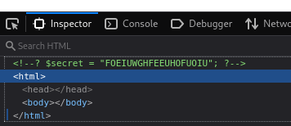
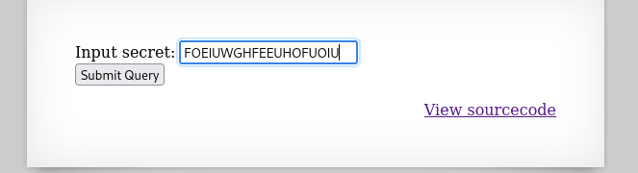
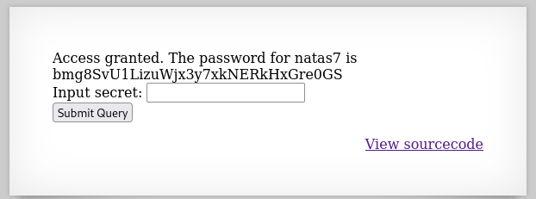
So I looked in the inspect element and there I saw the ‘secret’ variable I was looking for.
Once submitted I go the key to the next level.
Onwards!

Slide 4
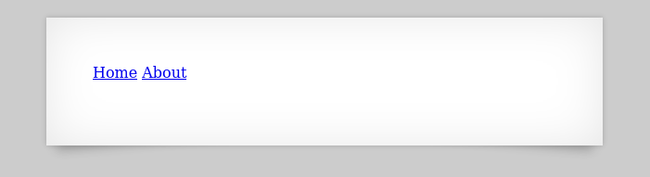


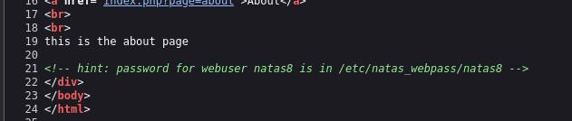
natas7:
So here we get two options. Home and about.
When I click on the home link the url at the top changes and displays the home page, and same with the about page.
When we look at the source code we see that the key to natas8 is in the file ‘/etc/natas_webpass/natas8’

Slide 5

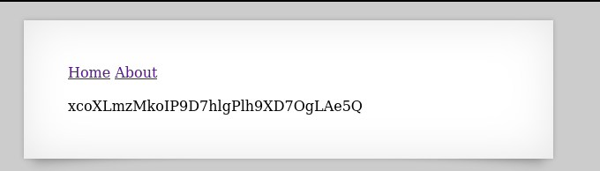
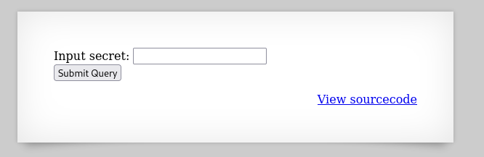
When appending the file path to the url we find the key to the next level.
Natas8:
Here we get a other query box that ask us for another secret so again lets look at the source code.

Slide 6
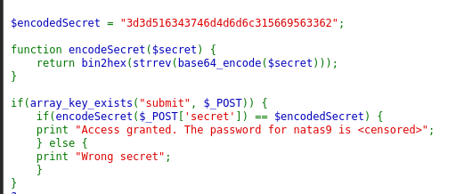



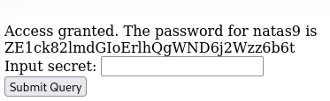
When looking at the source code we see a php function to encode the secret, and they give us the encoded secret.
So lets write a php function to do the opposite.
And as we see we get a weird string that if we try to input as the secret we get granted the key to natas9.

Slide 7
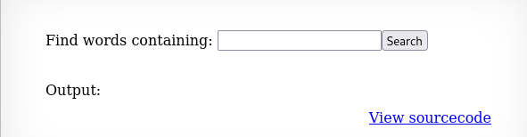

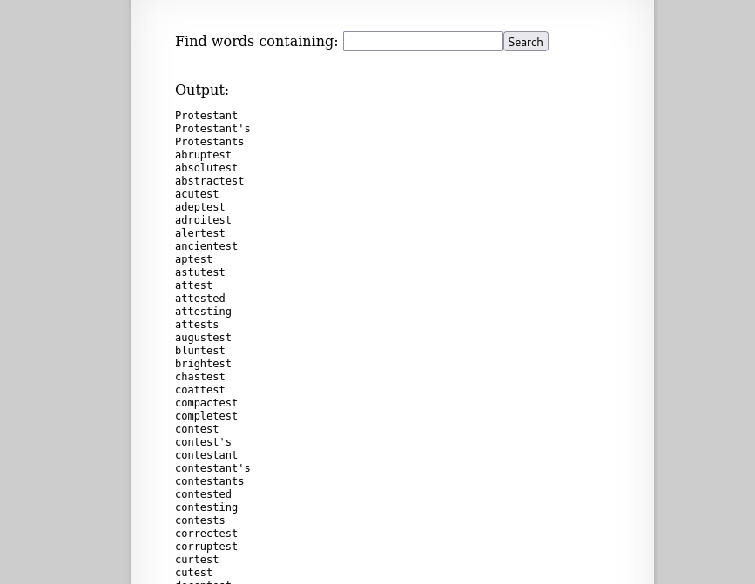
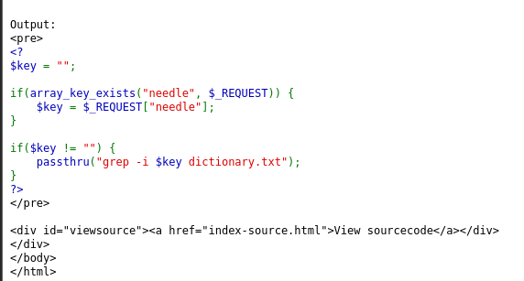
Natas9:
So here we get a query box that lets us search for words. As you see we input ‘test’ and get all words containing ‘test’.
If we look at the source code we see a nice opportunity to use command injection(using the build of the command to slip in a system command) so let try a simple ‘;pwd’.

Slide 8


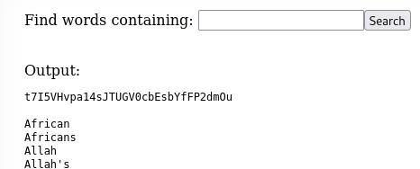
The ‘;’ character in bash command tells the shell to execute the command before it and then after first command is done to execute the command after the ‘;’.
So here wee see that the pwd command(shows where you are in the computer) was successful, so lets try something more interesting.
What I submitted was ‘key;cat /etc/natas_webpass/natas10’. The final command will search for the words that have the string key and read for us the natas10 file.
And there you have it!

Slide 9
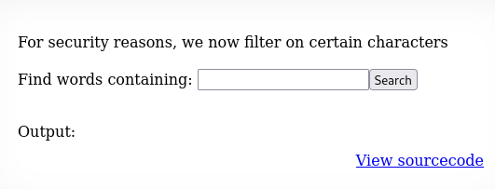
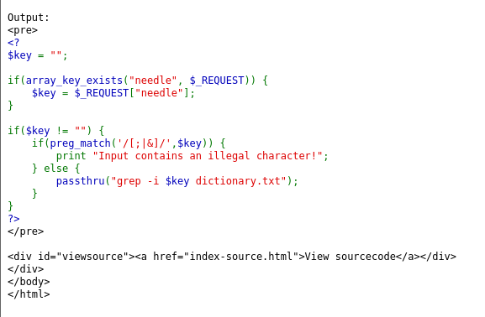
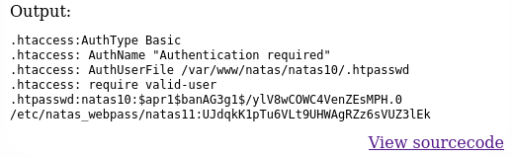
Natas10:
Here they are restricting us from using certain characters, if we look at the source code we can see that ‘;|&’ are forbidden.
So let work around it. Let manipulate the grep command it uses.
I submitted:
‘.* /etc/natas_webpass/natas11 #’ the hashtag at the end is to turn everything else into a comment.
and as wee see with the output we find the key to natas11.

